Slide 1

STOCK MARKET INVESTMENT STRATEGY
Presenter Name

Slide 2



Agenda
Problem statement
Introduction
Exploratory Data Analysis
Conclusion
Recommendations

Slide 3

What is the best long term investment strategy for a R100,000?

Slide 4


Introduction
S & P 500 giants: Microsoft and Amazon
Cryptocurrency giant: Bitcoin
Inflation rate

Slide 5

EXPLORATORY DATA ANALYSIS

Slide 6
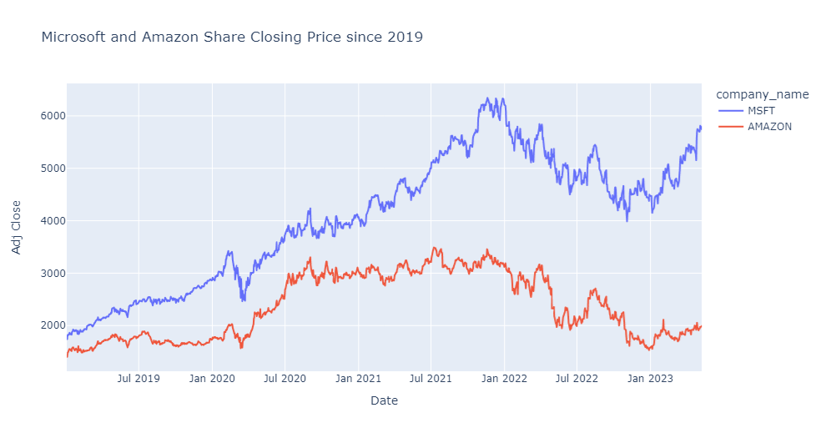
Closing Price : MSFT & AMZN

Slide 7
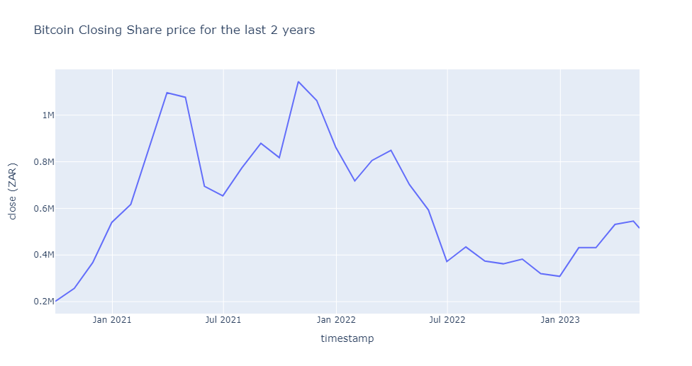
Closing Price Bitcoin

Slide 8
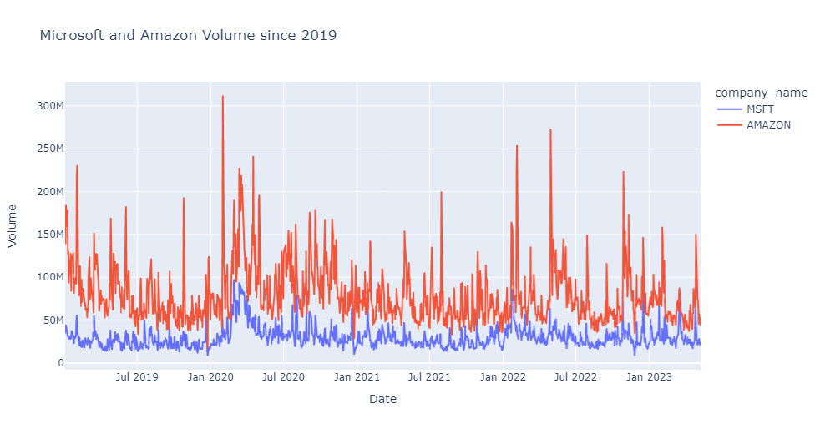
Sales Volume : MSFT & AMZN

Slide 9
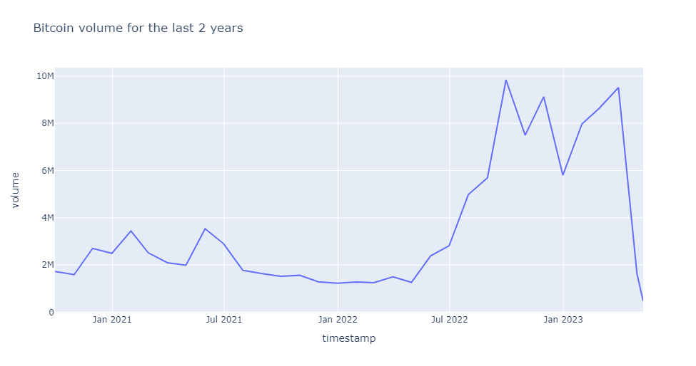
Sales Volume Bitcoin

Slide 10
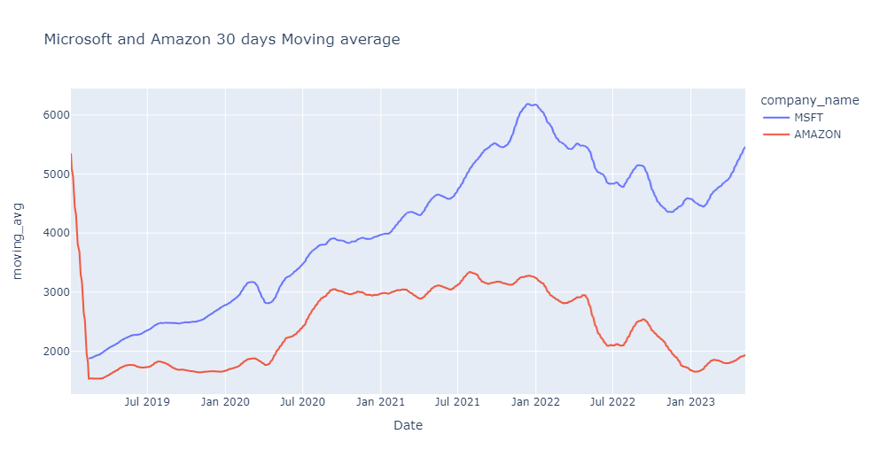
30-day Moving Average

Slide 11
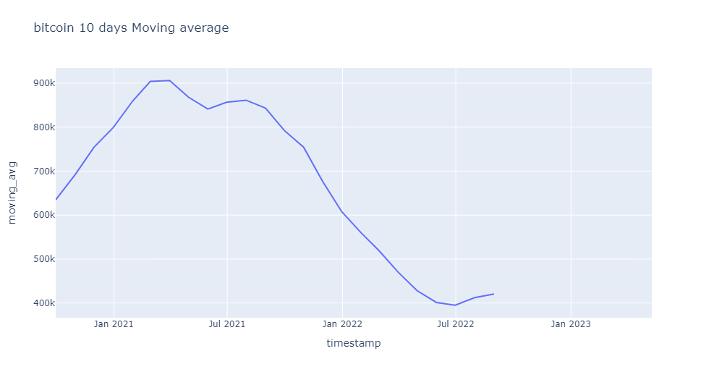
Bitcoin: 10-day Moving Average

Slide 12
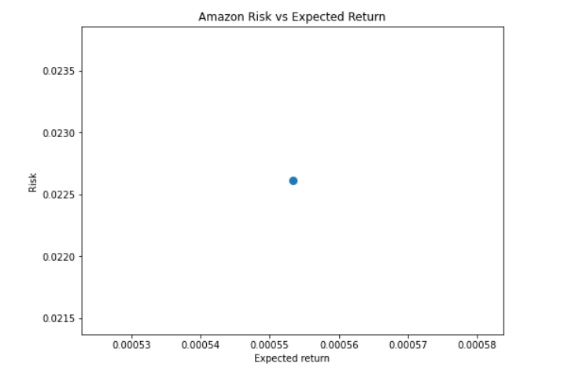
Amazon Risk vs Expected Return

Slide 13
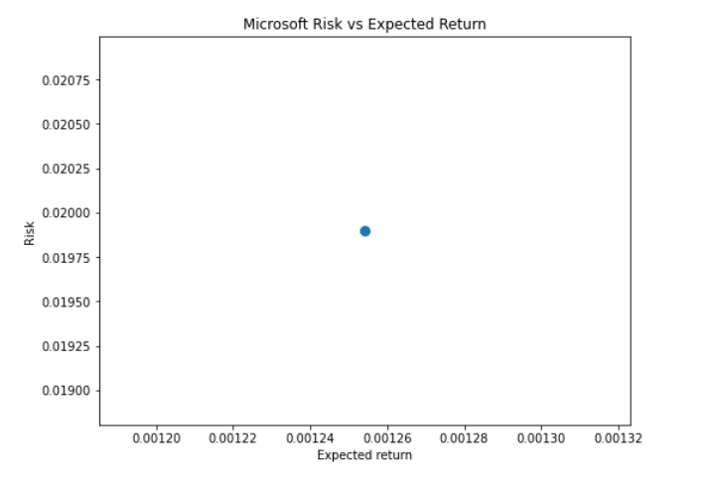
Microsoft Risk vs Expected Return

Slide 14
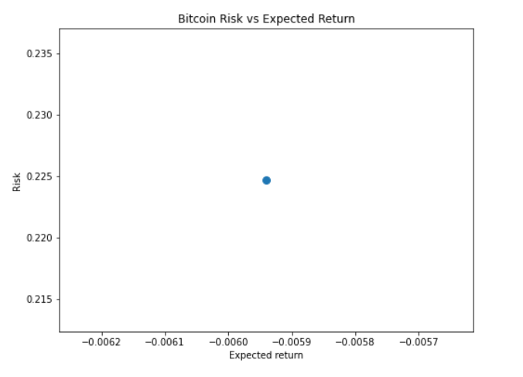
Bitcoin Risk vs Expected Return

Slide 15
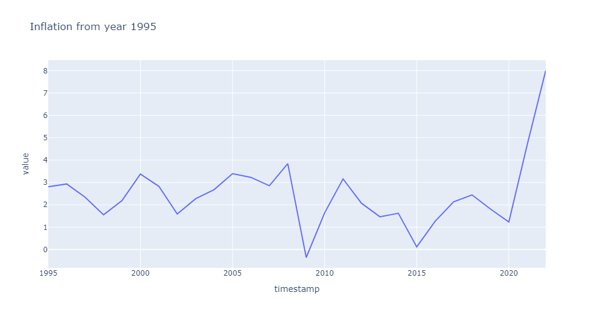
Inflation Rate

Slide 16
The way to get started is to quit talking and begin doing.
Walt Disney

Slide 17
Conclusion
Inflation seem to be increasing moving forwards.
Microsoft has a better risk to return.
Bitcoin is the worst
Investing in Microsoft could be the best strategy based on our analysis.

Slide 18
Recommendations
The analysis net can be wide to include other markets.
A forecasting model can be useful.
Domain knowledge can help in better insights.

Slide 19


Thank You

